Slide 1
Automatic Detection of Clickbait Headlines Using Semantic Analysis and Machine Learning Techniques
Mark Bronakowski , Mahmood Al-khassaweneh and Ali Al Bataineh , Engineering, Computing and Mathematical Sciences, Lewis University, Romeoville, IL 60446, USA,Department of Electrical and Computer Engineering, Norwich University, Northfield, VT 05663, USA.
Team No: 32
Members:
Saman Sarker Joy - 20101114
Tanusree Das Aishi - 20101012
Naima Tahsin Nodi - 20101150 (Presenting)
ST: Sadiul Arefin Rafi
RA: Md Sabbir Hossain

Slide 2
What the Research Paper is about?
This paper addresses the issue of clickbait headlines, which are misleading and used to attract clicks that can lead to malicious content.
The study presents a method for identifying clickbait headlines using semantic analysis and machine learning.
By analyzing thirty semantic features and employing six classification algorithms, the proposed models achieve a high accuracy of 98%. These models can serve as a basis for developing practical applications to automatically detect clickbait headlines.

Slide 3
Dataset
To train, test and validate the six algorithms, a large dataset of 32,000 sample headlines collected from different news websites was used. The dataset contained a 50/50 mix of clickbait and non-clickbait headlines.
Clickbait titles were collected from website like:
BuzzFeed, Upworthy, ViralNova, Thatscoop, Scoopwhoop and ViralStories.
Non-Clickbait titles are collected from:
Reliable sources like WikiNews, New York Times, The Guardian and The Hindu.

Slide 4
Preprocessing and Formulated
The data set formulation incorporates 30 key semantic features for clickbait headlines.
Features include sentence structure, parts-of-speech, forward referencing, punctuation, common clickbait words, and informality.
Clickbait headlines have a greater word count but shorter average word length.
Stop words and determiners are frequently used in clickbait headlines.
Forward referencing creates anticipation and curiosity.
Informality is measured using readability indices and formality measure index.
High-frequency words in clickbait headlines are identified.
Features include binary and numeric values for classification.

Slide 5
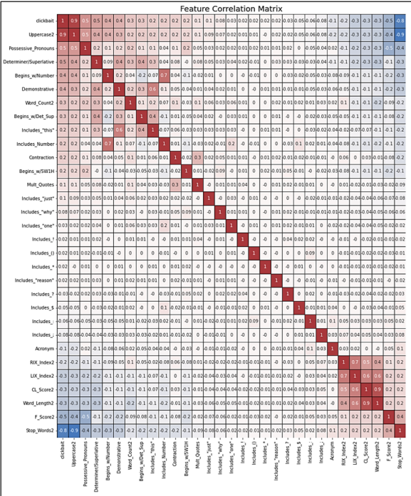
Models used in the paper
Six individual classification models were tested: decision tree, logistic regression, naïve Bayes, support vector machine (SVM), k-nearest neighbor (KNN), and gradient-boosted decision tree (GBDT).
Hyperparameters for each model were selected through a randomized search, optimizing accuracy, precision, and recall.
The SVM and GBDT models performed the best, achieving an accuracy of 0.98, precision of 0.98, and recall of 0.97.
Ensemble modeling of the top 5 models did not improve accuracy, with an average accuracy of 0.976.
Exploratory factor analysis was conducted, but factor-based models did not outperform feature-based models, achieving an accuracy of 0.98.
Image 1: Feature Correlation Matrix

Slide 6
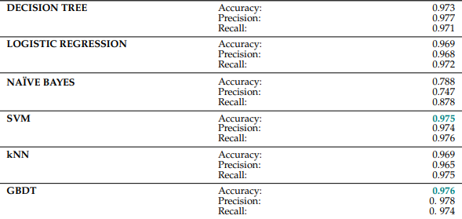
Experiments and Results

Slide 7
Some Drawbacks
Limited dataset.
Generalizability.
Focus on headlines only.
Need for content analysis.
Larger dataset evaluation.
Practical application.

Slide 8
Thank You.

